Slide 1
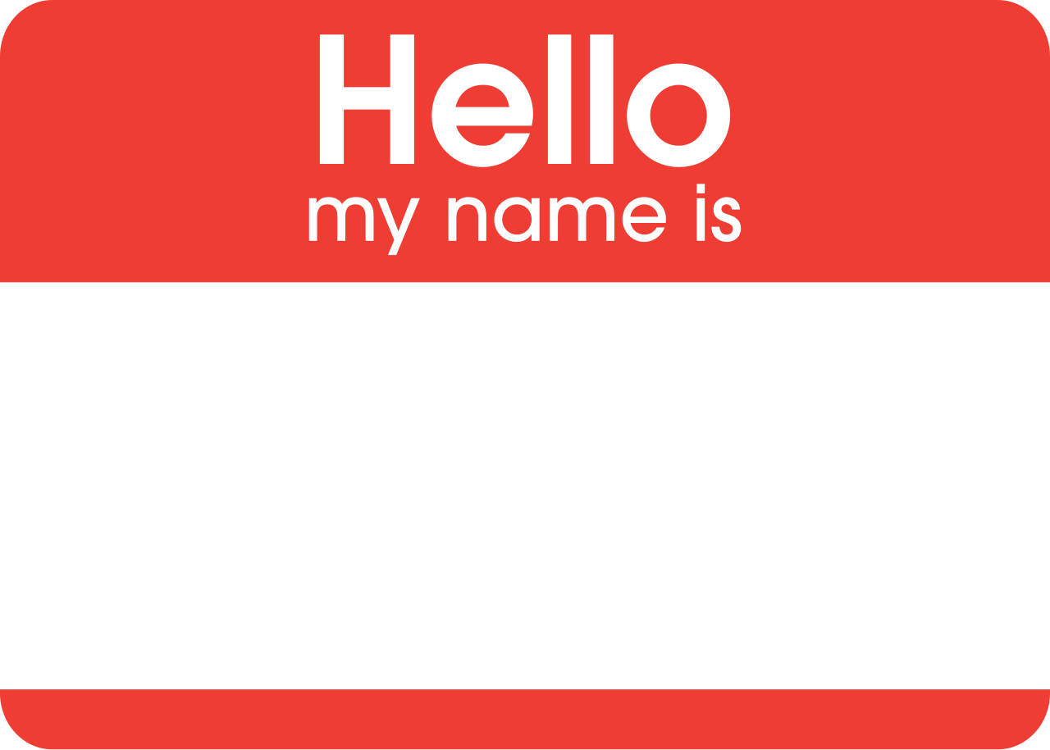
Name Games

Slide 2
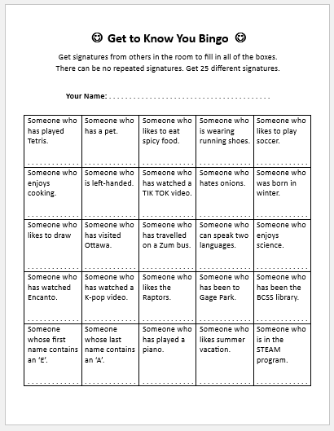
What’s going on right now?
Get to Know You Bingo
Walk around the room.
You want 25 different signatures!
If someone matches a description, they sign your paper.

Slide 3
A person's name is the greatest connection to their own identity and individuality....

Slide 4
A person's name is the greatest connection to their own identity and individuality....
Some might say it is the most important word in the world to that person.

Slide 5
A person's name is the greatest connection to their own identity and individuality....
Some might say it is the most important word in the world to that person.
When someone remembers our name after meeting us, we feel respected and more important.

Slide 6
A person's name is the greatest connection to their own identity and individuality....
Some might say it is the most important word in the world to that person.
When someone remembers our name after meeting us, we feel respected and more important.
It makes a positive and lasting impression on us.

