Slide 1
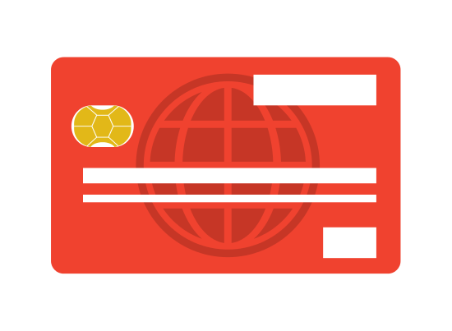
PIN Analysis
Never Pick 1234!
By Ida Knowe
For Ms. Gorski
July 2019

Slide 2

Common sense seems to dictate that banks have great security.

Slide 3

Banking security is important because our money needs to be safe.

Slide 4

And also because hacking financial information is on the rise.

Slide 5
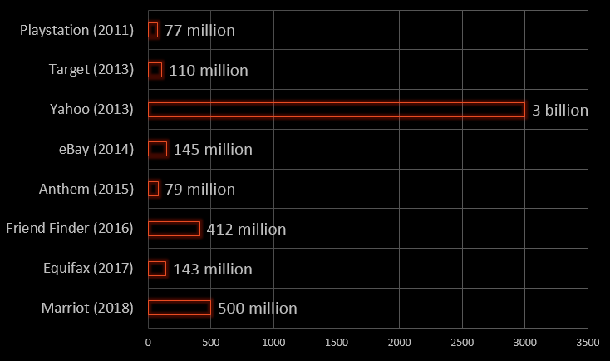
Each year’s largest hacks, in terms of compromised accounts:

Slide 6
While most people think banks have excellent security,
I believe that PINs create vulnerabilities for hackers to exploit.

Slide 7
How secure is your PIN?

Slide 8
It matters…..

Slide 9

The hacker’s point of access is often a weak password.

Slide 10

People are notoriously bad at
generating random passwords.

Slide 11
This report is intended to make you think more carefully about your choices.

Slide 12
Don’t be the weakest link.

Slide 13
Pick a secure PIN.

Slide 14
Methodology

Slide 15

Secondary data was used.
Using public postings of previous PIN hacks,
one-variable data was collected: 4 digit PINs.

Slide 16
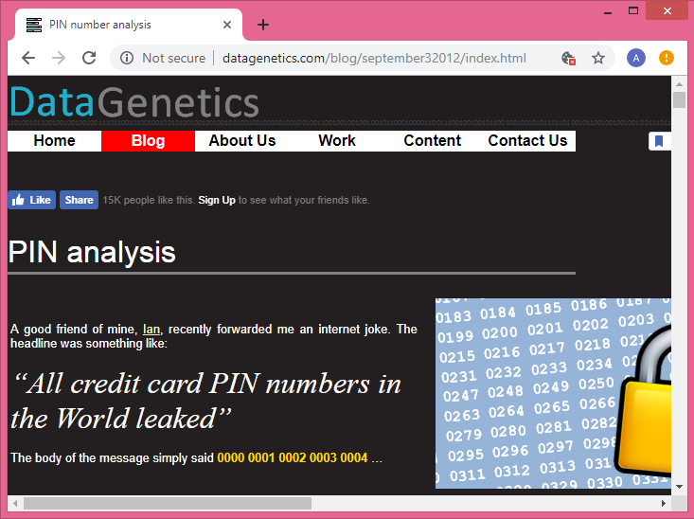
Specifically, this source was used:

Slide 17
n(Sample) = 3,400,000
3.4 million is statistically sound.
It has a low chance of error.

Slide 18
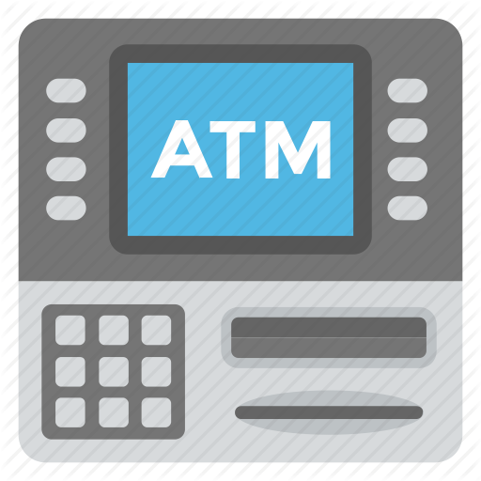
However, only publically available hacked datasets have been used.
These PIN listings are not as complete as a bank’s would be.

Slide 19
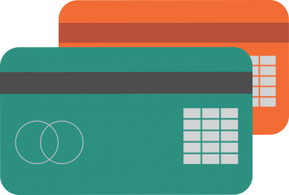
This is not a true random sample, there is a sampling bias towards lower level computer users.

Slide 20
Analysis

Slide 21
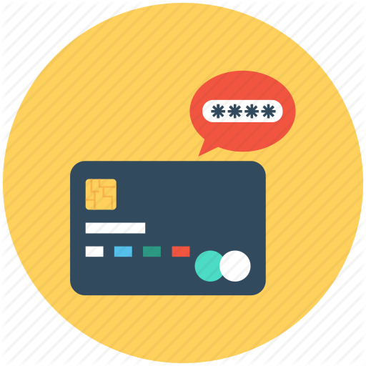
How many possible PIN codes exist?

Slide 22
Generally, most banking PINs are 4 digits.

Slide 23
Each space can hold 10 possible digits:
0, 1, 2, 3, 4, 5, 6, 7, 8, 9.

Slide 24
10
10
10
10
Each digit is independent, so the values
can be multiplied to get the total number.

Slide 25
10
10
10
10
10⁴ = 10,000 possible PINs

Slide 26

Which of these 10,000 pin numbers is the most predictable?

Slide 27
Which of these 10,000 pin numbers is the most predictable?
If you were given the task of trying to crack a random credit card by repeatedly trying PIN codes, what order should you try guessing to maximize your chances of selecting the correct number in the shortest time?

Slide 28
The most popular password is 1234.

Slide 29
The most popular password is 1234.
It’s staggering how popular this password appears to be…

Slide 30


1234
Nearly 11%
of the 3.4 million passwords
were 1234.

Slide 31
The most popular PIN of 1234 is more popular than
the lowest 4,200
numbers combined.

Slide 32
Rank | PIN | Frequency | Count
#1 | 1234 | 10.713 | 364242
#2 | 1111 | 6.016 | 204544
#3 | 0000 | 1.881 | 63954
#4 | 1212 | 1.197 | 40698
#5 | 7777 | 0.745 | 25330
#6 | 1004 | 0.616 | 20944
#7 | 2000 | 0.613 | 20842
#8 | 4444 | 0.526 | 17884
#9 | 2222 | 0.516 | 17544
#10 | 6969 | 0.512 | 17408
The 10 most common PINs show predictable user choices.

Slide 33
Rank | PIN | Frequency | Count
#1 | 1234 | 10.713 | 364242
#2 | 1111 | 6.016 | 204544
#3 | 0000 | 1.881 | 63954
#4 | 1212 | 1.197 | 40698
#5 | 7777 | 0.745 | 25330
#6 | 1004 | 0.616 | 20944
#7 | 2000 | 0.613 | 20842
#8 | 4444 | 0.526 | 17884
#9 | 2222 | 0.516 | 17544
#10 | 6969 | 0.512 | 17408
The 10 most common PINs show predictable user choices.
One repeated digit

Slide 34
Rank | PIN | Frequency | Count
#1 | 1234 | 10.713 | 364242
#2 | 1111 | 6.016 | 204544
#3 | 0000 | 1.881 | 63954
#4 | 1212 | 1.197 | 40698
#5 | 7777 | 0.745 | 25330
#6 | 1004 | 0.616 | 20944
#7 | 2000 | 0.613 | 20842
#8 | 4444 | 0.526 | 17884
#9 | 2222 | 0.516 | 17544
#10 | 6969 | 0.512 | 17408
The 10 most common PINs show predictable user choices.
One repeated digit
Couplets of 69 or 12

Slide 35
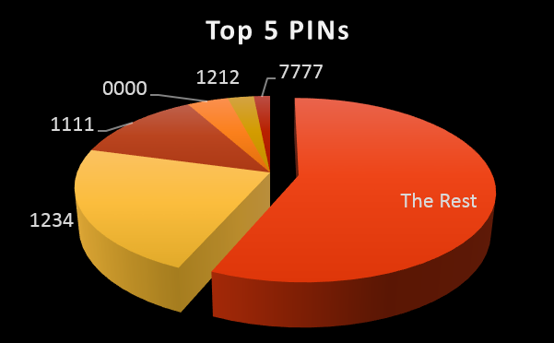
The top 5 PINs account for 21% of all PINs.

Slide 36

Other common PINs are:
  1111
  2222
  3333
  9999
  1212
  1122
  1313
  4321
  1010

Slide 37
Other common PINs are:
  1111
  2222
  3333
  9999
  1212
  1122
  1313
  4321
  1010
One digit repeated!

Slide 38
Other common PINs are:
  1111
  2222
  3333
  9999
  1212
  1122
  1313
  4321
  1010
One digit repeated!
Couplets repeated!

Slide 39
Other common PINs are:
  1111
  2222
  3333
  9999
  1212
  1122
  1313
  4321
  1010
One digit repeated!
Couplets repeated!
Sigh. It’s 1234 again.

Slide 40
2001 makes an appearance at #19.

Slide 41
2001 makes an appearance at #19.
James Bond fans may wish to know 0007 is in position #23.

Slide 42
2001 makes an appearance at #19.
James Bond fans may wish to know 0007 is in position #23.
1984 follows not far behind in position #26.

Slide 43
How probable are poor PIN choices?

Slide 44
Hackers can guess 1/3 of all PINs by trying only 61 combinations!

Slide 45
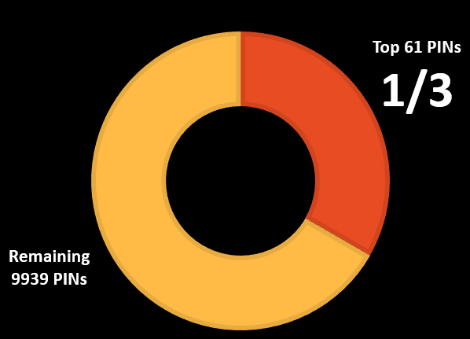
What the odds are:
Hackers can guess 1/3 of all PINs by trying only 61 combinations!

Slide 46
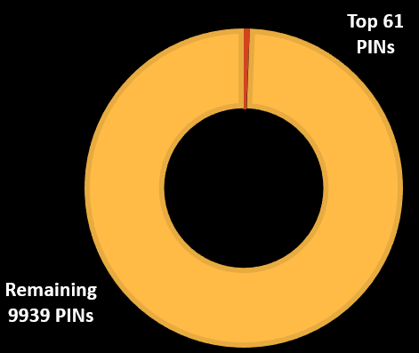
If humans were good at random, this is what it should be:
What the odds are:
Hackers can guess 1/3 of all PINs by trying only 61 combinations!

Slide 47
Choosing one of the top passwords is reduces the work for a brute force password cracker.

Slide 48
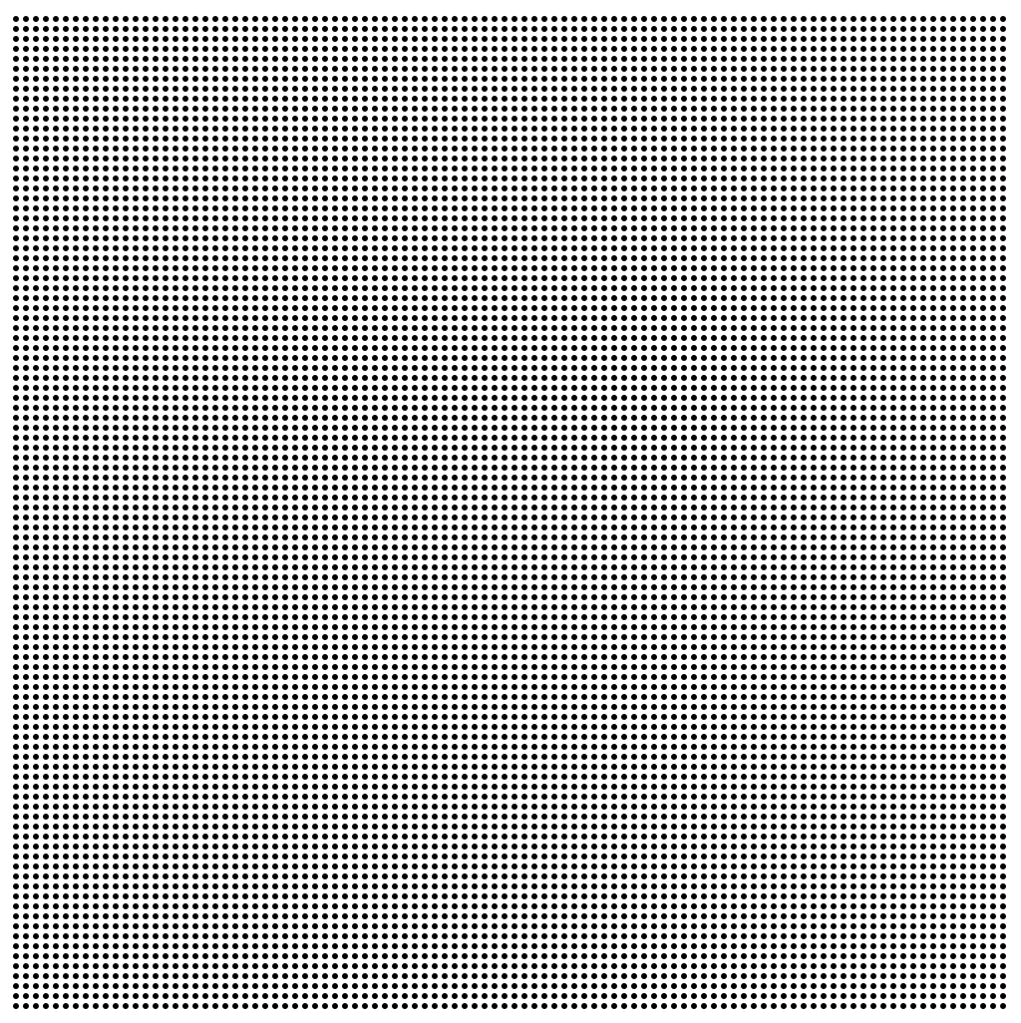
Choosing one of the top passwords is reduces the work for a brute force password cracker.
Random choices
10,000
tries

Slide 49

Choosing one of the top passwords is reduces the work for a brute force password cracker.
Random choices
Our poor choices
10,000
tries
61
tries

Slide 50
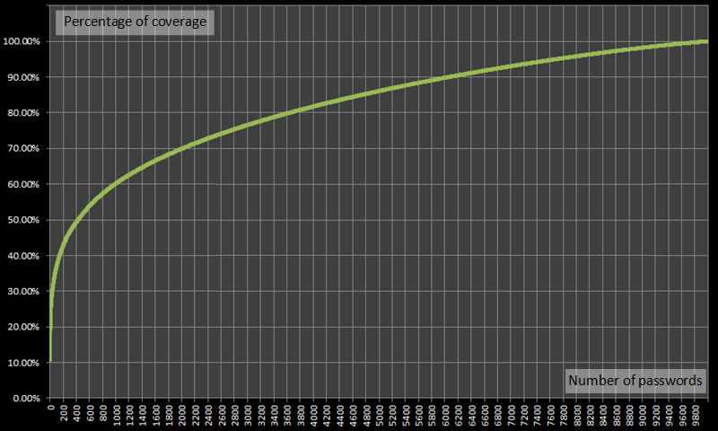
Cumulative Frequency Graph 4 Digit PIN Codes
That's right, a hacker could crack over 10% of all PINs with one guess!

Slide 51
Cumulative Frequency Graph 4 Digit PIN Codes
That's right, a hacker could crack over 10% of all PINs with one guess!
Expanding this, they could get 20% by using just five numbers!

Slide 52
Cumulative Frequency Graph 4 Digit PIN Codes
If passwords were uniformly randomly distributed, we would expect the top twenty passwords to account for just 0.2% of the total, not the 26.83% encountered
That's right, a hacker could crack over 10% of all PINs with one guess!
Expanding this, they could get 20% by using just five numbers!

Slide 53

A lot of people avoid the common PINs, but pick a significant year instead.

Slide 54
The problem with a using a year as a PIN…..
Everyone else is too.

Slide 55
The following graph plots all of the PINs in the form XX72.
So 0072 is on the left
and 9972 is on the right.

Slide 56
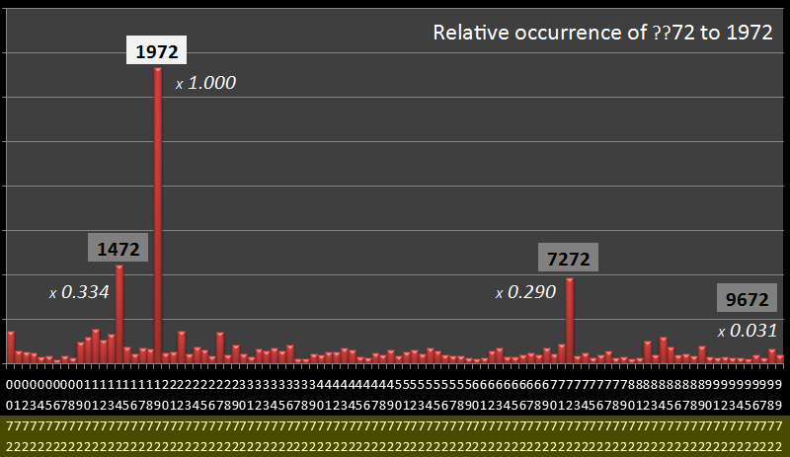

Slide 57
A year.

Slide 58
Couplet
A year.

Slide 59
Couplet
A year.
The ratio of 1972 to all the other XX72 PINS is 22:1

Slide 60
1
(1)
1
(9)
10
10
The use of a 1900 PIN reduces the possibilities from:
10⁴ = 10,000 possible PINs
To an easy brute force attack of:
10² = 100 possible PINs

Slide 61
The following graph plots the frequencies of all of the PINs that start with 19XX
So 1900 is on the left
and 1999 is on the right.

Slide 62
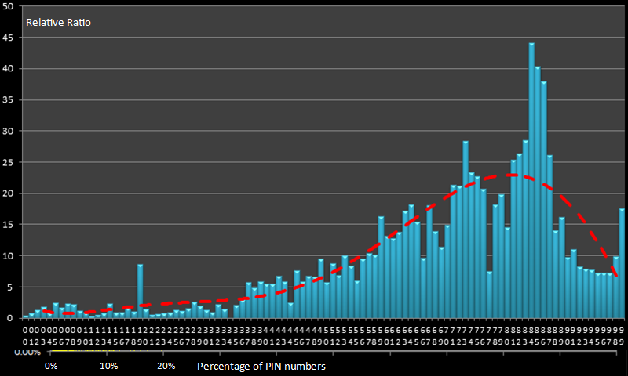

Slide 63
You can see the frequency of each year.

Slide 64
You can see the frequency of each year.
What’s interesting is that it matches the demographic chart line (red)

Slide 65
You can see the frequency of each year.
What’s interesting is that it matches the demographic chart line (red)
Thus, the year people are picking is often their birthday.

Slide 66
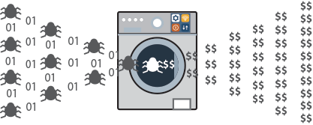
All the hacker needs to do is check social media, find your birth year and try it as you PIN. Easy.

Slide 67

What can heat maps indicate about PIN probability?

Slide 68
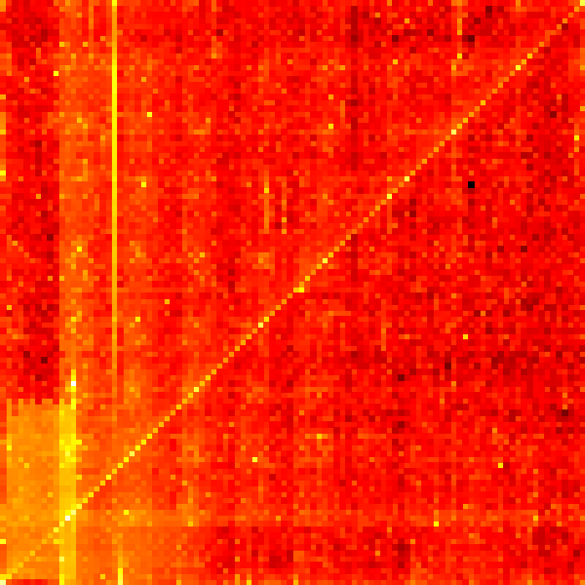
99
A heat map shows frequency with colour.
Last 2 PIN Digits
00
First 2 PIN digits
99

Slide 69
99
A heat map shows frequency with colour.
Frequent
White
Yellow
Orange
Red
Brown
Black
Infrequent
Last 2 PIN Digits
00
First 2 PIN digits
99

Slide 70
99
A heat map shows frequency with colour.
Frequent
White
Yellow
Orange
Red
Brown
Black
Infrequent
White, very frequent
Last 2 PIN Digits
00
First 2 PIN digits
99

Slide 71
99
A heat map shows frequency with colour.
Frequent
White
Yellow
Orange
Red
Brown
Black
Infrequent
White, very frequent
Last 2 PIN Digits
1234
00
First 2 PIN digits
99

Slide 72
99
A heat map shows frequency with colour.
Frequent
White
Yellow
Orange
Red
Brown
Black
Infrequent
White, very frequent
Last 2 PIN Digits
1234
34
12
00
First 2 PIN digits
99

Slide 73
99
If PINs were unpredictable, frequencies would be equal –a red square would appear.
Last 2 PIN Digits
Uniform frequencies
00
First 2 PIN digits
99

Slide 74
99
The white and yellow represent vulnerable passwords.
Last 2 PIN Digits
Uniform frequencies
00
First 2 PIN digits
99

Slide 75
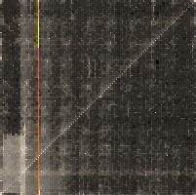

99
The diagonal represents couplets like 1212 or 8989.
Last 2 PIN Digits
00
First 2 PIN digits
99

Slide 76
99
Every eleventh dot on the diagonal is extra bright – all 4 four digits are the same.
Last 2 PIN Digits
00
First 2 PIN digits
99

Slide 77
99
This line represents the 19XX or year based passwords.
Recent dates are more common.
Last 2 PIN Digits
00
First 2 PIN digits
99

Slide 78
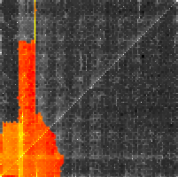
99
There is a strong bias to the lower left.
People like to start their PINs with 0 or 1.
Last 2 PIN Digits
00
First 2 PIN digits
99

Slide 79
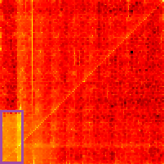
99
People also use dates in the format MMDD.
There is increased frequency between the height of 30-31 (days in a month),
to 12
on the
x-axis.
Last 2 PIN Digits
MM between 1 and 12
DD
1 and 31
00
First 2 PIN digits
99

Slide 80
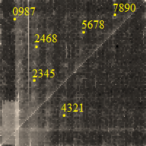
99
Numerical runs also appear; such as 2345, 4321 and 5678.
Last 2 PIN Digits
00
First 2 PIN digits
99

Slide 81
99
The most infrequently used PIN was 8068.
8068
Last 2 PIN Digits
00
First 2 PIN digits
99

Slide 82

How does PIN length impact security?

Slide 83
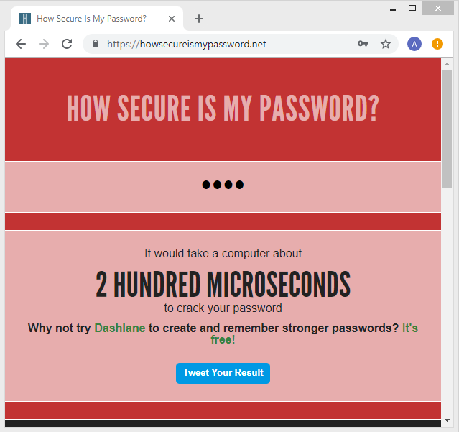
A variety of PINs where entered to this site.
A brute force cracked each and timed it.

Slide 84
PIN | Length | Time | Time (sec)
3 | 1 | 3 hundred picosec | 1E-12
33 | 2 | 3 nanosec | 1E-09
338 | 3 | 25 nanosec | 1E-08
3389 | 4 | 2 hundred nanosec | 1E-07
33899 | 5 | 3 microsec | 0.000001
338994 | 6 | 3 hundred microsec | 0.0001
3389943 | 7 | 3 millisec | 0.001
33899431 | 8 | 25 millisec | 0.01
338994314 | 9 | 3 hundred millisec | 0.1
3389943147 | 10 | 3 sec | 1
33899431479 | 11 | 25 sec | 10
338994314797 | 12 | 4 min | 100
3389943147971 | 13 | 42 min | 1000
33899431479716 | 14 | 7 hours | 10000
338994314797169 | 15 | 3 days | 100000
3389943147971690 | 16 | 4 weeks | 1000000
33899431479716905 | 17 | 10 months | 10000000
338994314797169058 | 18 | 8 years | 1E+08
3389943147971690587 | 19 | 79 years | 1E+09
33899431479716905878 | 20 | 8 hundred years | 1E+10

Slide 85
PIN | Length | Time | Time (sec)
3 | 1 | 3 hundred picosec | 1E-12
33 | 2 | 3 nanosec | 1E-09
338 | 3 | 25 nanosec | 1E-08
3389 | 4 | 2 hundred nanosec | 1E-07
33899 | 5 | 3 microsec | 0.000001
338994 | 6 | 3 hundred microsec | 0.0001
3389943 | 7 | 3 millisec | 0.001
33899431 | 8 | 25 millisec | 0.01
338994314 | 9 | 3 hundred millisec | 0.1
3389943147 | 10 | 3 sec | 1
33899431479 | 11 | 25 sec | 10
338994314797 | 12 | 4 min | 100
3389943147971 | 13 | 42 min | 1000
33899431479716 | 14 | 7 hours | 10000
338994314797169 | 15 | 3 days | 100000
3389943147971690 | 16 | 4 weeks | 1000000
33899431479716905 | 17 | 10 months | 10000000
338994314797169058 | 18 | 8 years | 1E+08
3389943147971690587 | 19 | 79 years | 1E+09
33899431479716905878 | 20 | 8 hundred years | 1E+10
A four digit pin takes a password cracker a couple hundred microseconds to crack.

Slide 86
PIN | Length | Time | Time (sec)
3 | 1 | 3 hundred picosec | 1E-12
33 | 2 | 3 nanosec | 1E-09
338 | 3 | 25 nanosec | 1E-08
3389 | 4 | 2 hundred nanosec | 1E-07
33899 | 5 | 3 microsec | 0.000001
338994 | 6 | 3 hundred microsec | 0.0001
3389943 | 7 | 3 millisec | 0.001
33899431 | 8 | 25 millisec | 0.01
338994314 | 9 | 3 hundred millisec | 0.1
3389943147 | 10 | 3 sec | 1
33899431479 | 11 | 25 sec | 10
338994314797 | 12 | 4 min | 100
3389943147971 | 13 | 42 min | 1000
33899431479716 | 14 | 7 hours | 10000
338994314797169 | 15 | 3 days | 100000
3389943147971690 | 16 | 4 weeks | 1000000
33899431479716905 | 17 | 10 months | 10000000
338994314797169058 | 18 | 8 years | 1E+08
3389943147971690587 | 19 | 79 years | 1E+09
33899431479716905878 | 20 | 8 hundred years | 1E+10
A four digit pin takes a password cracker a couple hundred microseconds to crack.
Banks naturally have a lot of safeguards against crackers, but this is still concerning.

Slide 87
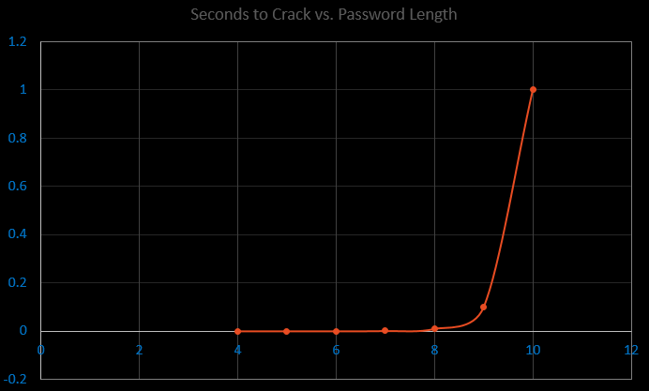
Cracking time grows exponentially with password length.

Slide 88

The 4 digit PIN was created in 1967 when crackers where less powerful.

Slide 89
The 4 digit PIN was created in 1967 when crackers where less powerful.
Banks need to consider longer PINs to increase security against modern computers.

Slide 90
Conclusions

Slide 91

To foil hackers,
pick PINs randomly!

Slide 92
To foil hackers,
pick PINs randomly!
No 1234

Slide 93
To foil hackers,
pick PINs randomly!
No 1234
Avoid the top 20

Slide 94
To foil hackers,
pick PINs randomly!
No 1234
Avoid the top 20
No couplets

Slide 95
To foil hackers,
pick PINs randomly!
No 1234
Avoid the top 20
No couplets
Avoid years

Slide 96
To foil hackers,
pick PINs randomly!
No 1234
Avoid the top 20
No couplets
Avoid years
Avoid MMDD

Slide 97

Banks also need to make changes.

Slide 98
Banks also need to make changes.
Policies to stop poor PIN choice

Slide 99
Banks also need to make changes.
Policies to stop poor PIN choice
Longer PINs

Slide 100

Protect yourself.

Slide 101
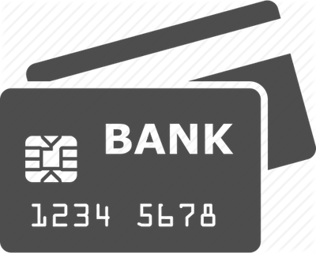
Pick a secure PIN.

