Slide 1
1. Make the screens using PowerPoint.
It’s easier to edit.
Keep in mind the 400 x 400 screen size

Slide 2
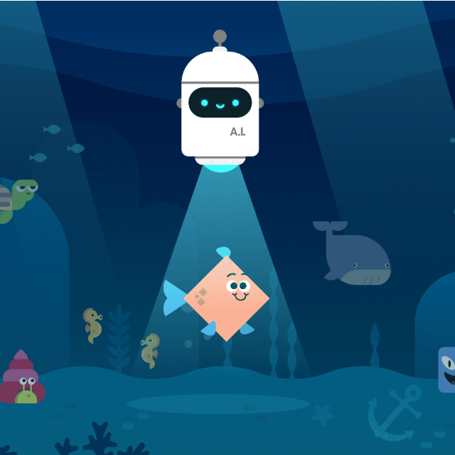
Note that it is a square!!!
Game Lab is square too.
Splash Animation
Picture or background
Title of game is displayed
Coder’s name is displayed
Key press to enter game or instructions; it works
Colour scheme & Theme evident
Outstanding opening screen design
Ocean AI
Ida Knowe
Press ‘e’ to enter

Slide 3

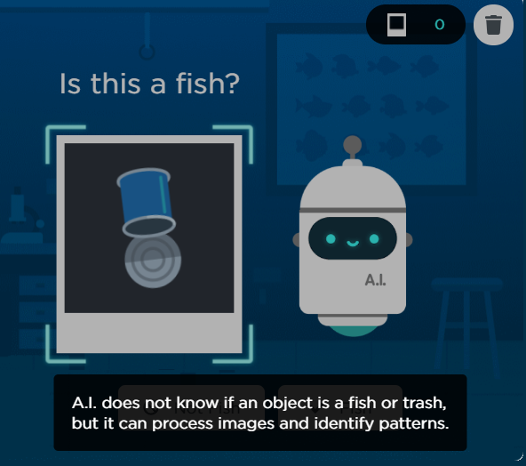
OceanAI Instructions
Instructions Animation
Title
Colour scheme & Theme evident
Game purpose & objective
Screen snapshots
Labelled screen snapshots
Clear about levels’ needed
Key press to enter game; it works
Everything is spelled correctly
No spelling or grammar errors.
Pictures of game to illustrate game
Not earned:
(you’d need a second screen)
Excellent and detailed instructions
Game Purpose: To teach the OceanAI bot how to recognize fish.
Objective: To remove 25 pieces of garbage and NO fish.
Pictures will scroll across the screen.
Press ‘n’ to delete the garbage and ‘y’ to save the fish.
Total pictures trained
Training Picture
To restart the game
Ocean AI bot, use arrow keys to move
Instructions Panel
Press ‘n’ to enter game

Slide 4
This is the background to the game.
Note the consistency of colour scheme with the other screens.
In fact, in this example, the instructions screen was created on this background to add consistency.

Slide 5
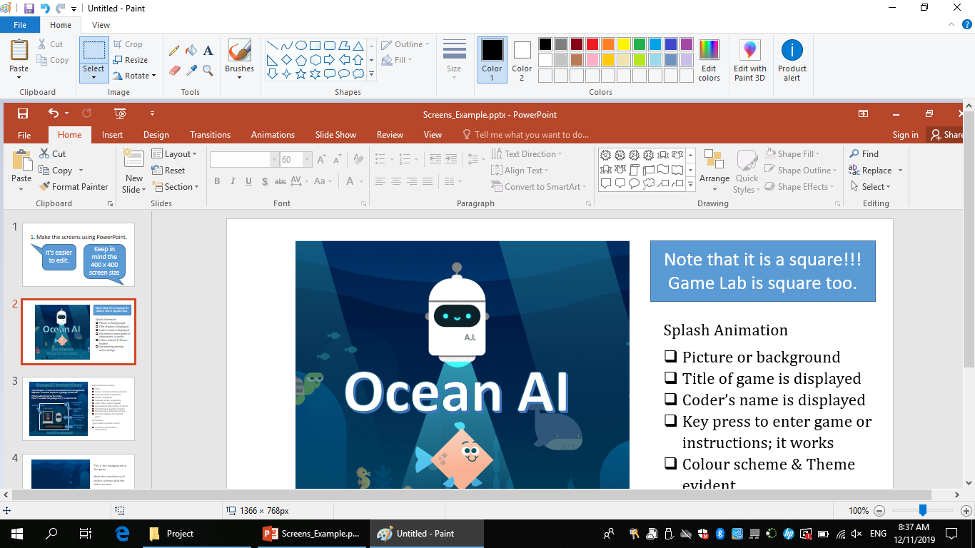
2. Choose prt scr and paste into Paint.

Slide 6
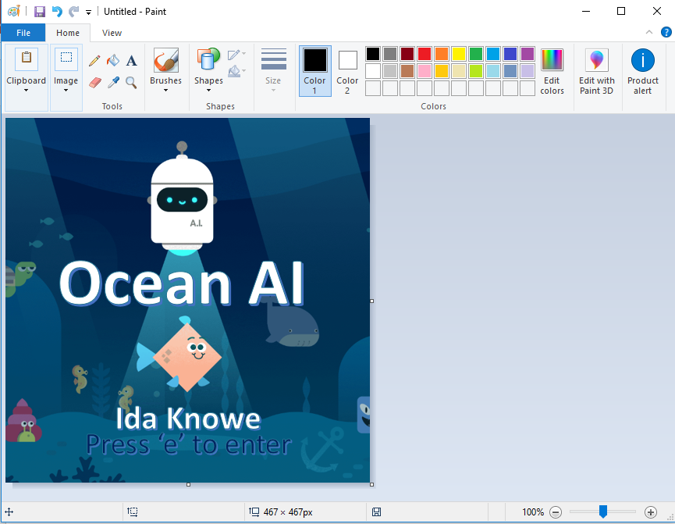
Select all and move the image so it is in the corner.
When you are done, there will be no white space around the picture.
All the PowerPoint stuff will be gone too.
Then, drag in the bottom left corner until you have a perfect square.

Slide 7
It will look like this. Only the screen.

Slide 8
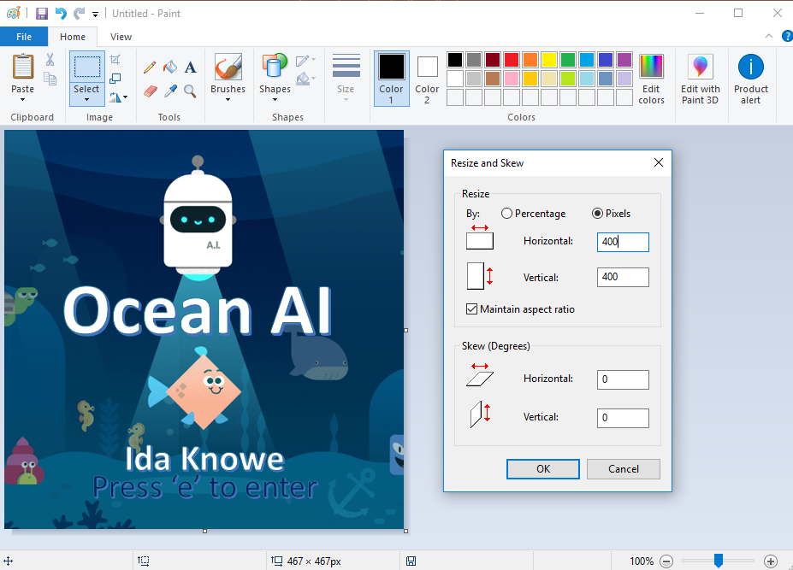
Resize your image to be 400 x 400. Then, save it and you can upload it to GameLab.

